Slide 1


Library Management System: Admin Panel
Welcome! This presentation will guide you through the development and implementation of a robust library management system, designed to streamline administrative tasks and enhance the library experience.
presented by . Veerabommala Anjan Bhargav

Slide 2
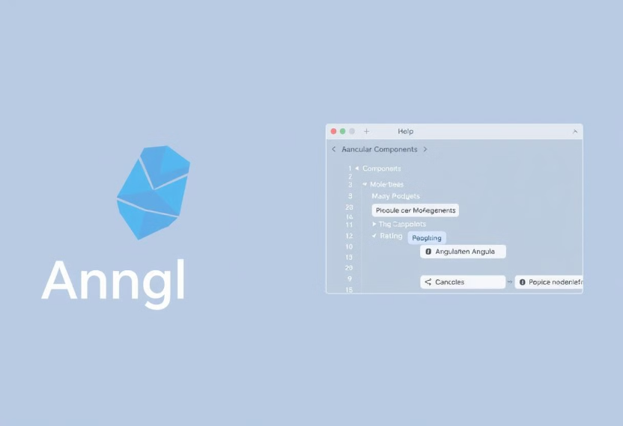

System Architecture: Front-End & Back-End
Front-End
Back-End
The front-end of our system is built using Angular, a powerful framework for building dynamic, single-page applications.
The back-end is powered by Spring Boot, a robust and efficient framework for building RESTful APIs.

Slide 3

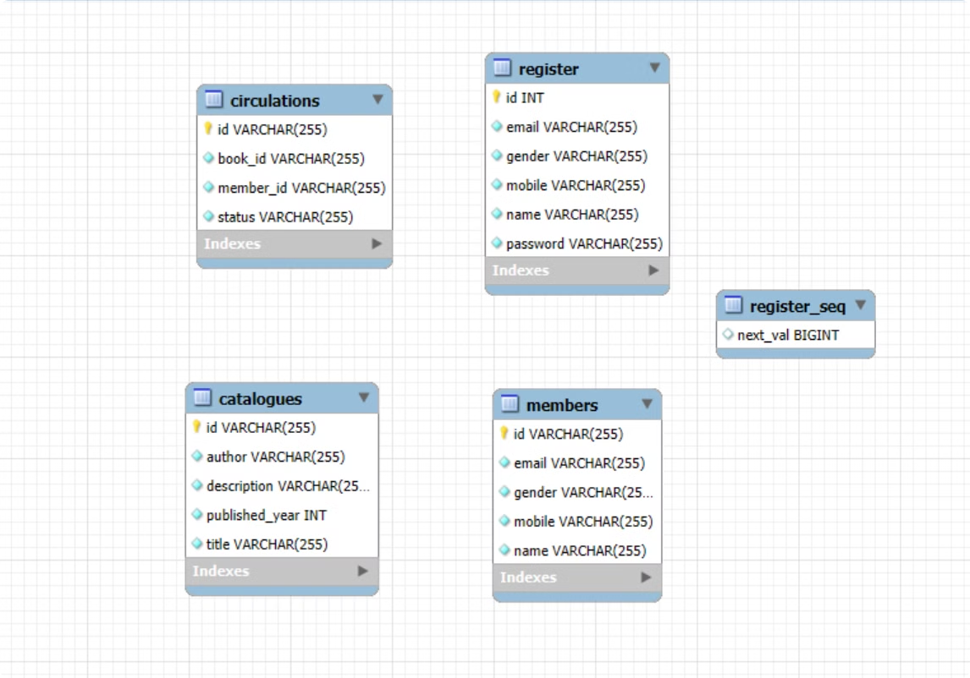
Data Management: MySQL Integration
A secure and efficient data management system is crucial for a library management system.
Maven will automatically create the tables in data base by using the entity as the structure of the table in the relational database.

Slide 4





Data Management: MySQL Integration
1
Database
Entity
2
The core data model representing library resources, members, and circulation records.
Repository
3
Abstraction layer responsible for data access operations, leveraging JPA.
Service
4
Provides business logic for managing data and interacting with the repository.
Controller
5
RESTful API endpoints for handling data requests from the front-end.

Slide 5

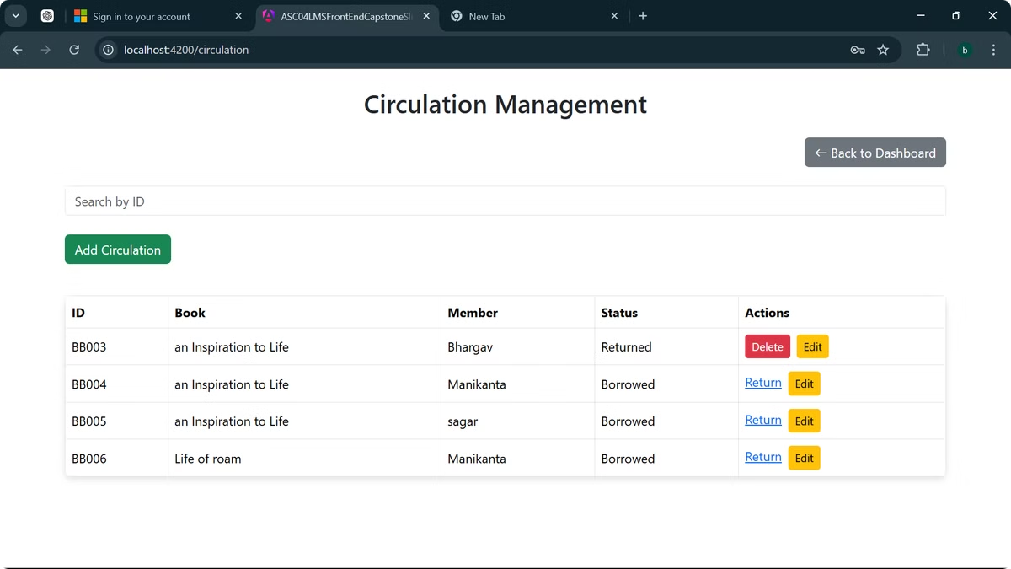
Core Functionality: CRUD Operations
1
Create
2
Read
Administrators can add new library resources, members, and circulation records.
Administrators can view detailed information about existing library resources, members, and circulation records.
3
Update
4
Delete
Administrators can modify existing data, such as updating member details or returning borrowed books.
Administrators can remove outdated or unnecessary data from the system.

Slide 6
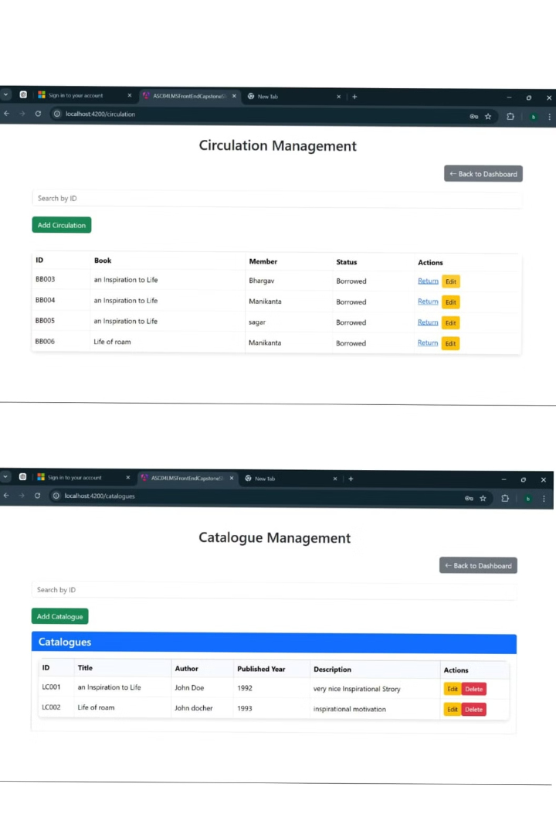


Library Resources: Catalogues & Circulation
Catalogues
Circulation
The system features a comprehensive catalogue of library resources, including books, journals, and other materials.
The system manages the lending and returning of library resources, ensuring accurate tracking and record keeping.

Slide 7

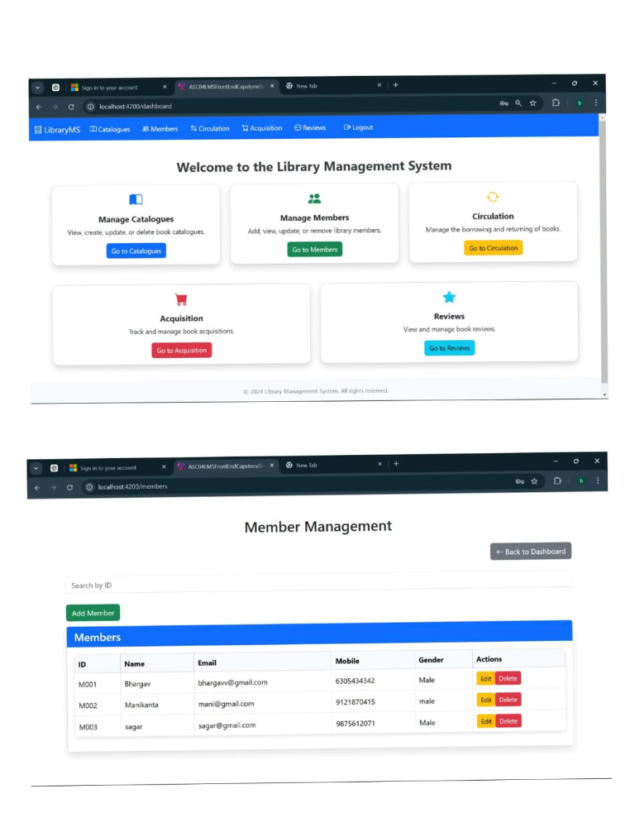
Member Management & Dashboard
Member Data
Dashboard
The system maintains detailed information about library members, such as contact details, borrowing history, and membership status.
The administrator dashboard provides a comprehensive overview of the library's operations, including member activity, resource availability, and circulation trends.

Slide 8
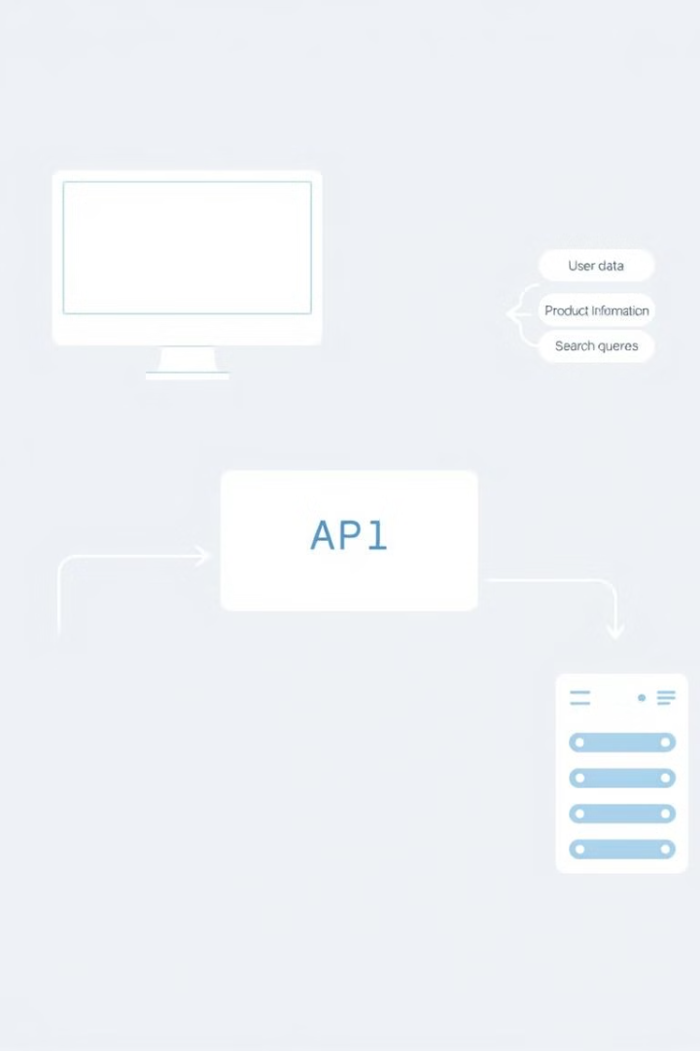
Front-End Integration: Service & Connection
1
Service
The front-end utilizes dedicated service files to communicate with the back-end APIs.
2
Connection
The front-end connects to the back-end using cross-origin communication, ensuring secure data exchange.
3
Data Retrieval
The front-end retrieves data from the back-end using GET requests, populating the UI with relevant information.

Slide 9
Challenges: Connecting Data
Ensuring accurate and consistent data flow between member and resource components
Maintaining data integrity during circulation operations
Handling potential data conflicts and inconsistencies
Optimizing data retrieval and processing for efficient user interactions

Slide 10

Conclusion
This presentation provided an overview of the Library Management System.
The system offers a comprehensive set of features for managing library resources, members, and circulation.

Slide 11

Thank You
This presentation outlined the development and features of the Library Management System.

